Slide 1
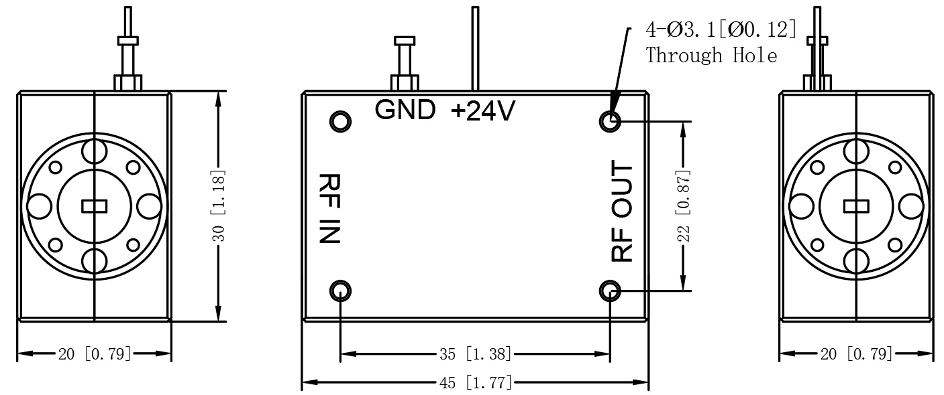


Description:
The amplifier is a power amplifier with a typical small signal gain of 35 dB and Psat of 23 dB across the frequency range of 76 to 81 GHz. The DC power requirement for the amplifier is +24 VDC/600 mA. Accept customization according to different needs.
Radar Systems
Communication Systems
Receivers Systems
Electrical Specifications（+25℃）:
Parameter | Min. | Typ. | Max. | Units
Frequency Range | 76-81 |  |  | GHz
Gain | 30 | 35 |  | dB
Gain Flatness |  | ±3 |  | dB
Input VSWR |  | 2.5 |  | -
Output VSWR |  | 2.0 |  | -
Output Power for (P1dB) |  | 23 |  | dBm
Output Power Past |  | 25 |  | dBm
Input Max Power(no damage) |  |  | +5 | dBm
DC Current (Vcc=+24V) |  | 600 |  | mA
Impedance | / |  |  | Ω
Input/Output Connector | WR10 UG-387/U
Material | Aluminium\Gold Painting
Package Sealing | General Sealing (Standard)
Environmental Specifications:
※ Operational Temperature | 0℃~+50℃
※ Storage Temperature | -55℃~+125℃
OBSERVE
PRECAUTIONS ELECTROSTATIC SENSITIVE DEVICES
1

