Slide 1


Description:
The power amplifier is a 2W power amplifier with a typical small signal gain of 35 dB across the frequency range of 0.1 to 22 GHz. The typical output power P-1 30dBm. The DC power requirement for the amplifier is +24 VDC/0.9 A. Accept customization according to different needs.
Radar Systems
Communication Systems
Receivers Systems
Electrical Specifications（+25℃）:
Parameter | Min. | Typ. | Max. | Units
Frequency Range | 0.1-22 |  |  | GHz
Gain | 33 | 35 |  | dB
Gain Flatness |  | ±2.5 |  | dB
Input VSWR |  | 2.0 |  | -
Output VSWR |  | 2.0 |  | -
Noise Figure |  | 5 |  | dB
Output Power for (P1dB) |  | 30 |  | dBm
Output Power Psat |  | 33 |  | dBm
Spurious |  | -60 |  | dBc
Input Max Power(no damage) |  |  | 5 | dBm
DC Current(Vcc=+18V)(@P1dB) |  | 0.8 | 0.9 | A
Impedance | 50 |  |  | Ω
Input/Output Connector | SMA-Female/SMA-Female
Material | Aluminium
Weight | 50g
Package Sealing | General Sealing (Standard)
Environmental Specifications:
※ Operational Temperature | -25℃~+85℃
※ Storage Temperature | -55℃~+125℃
OBSERVE
PRECAUTIONS ELECTROSTATIC SENSITIVE DEVICES
1

Slide 2
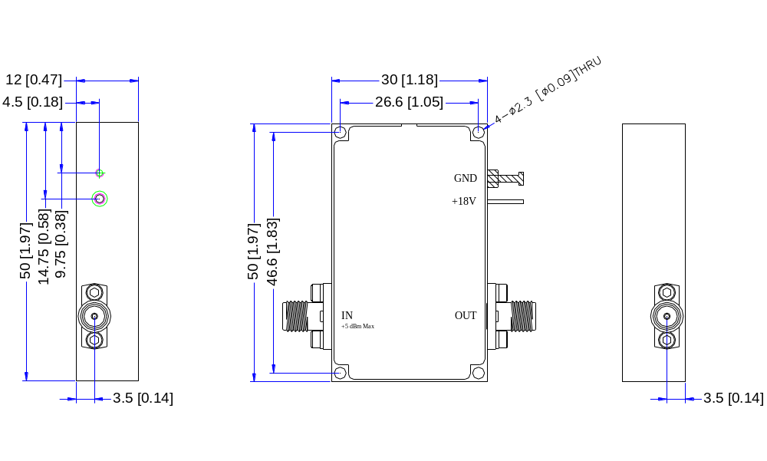
Outline Drawing
All Dimensions in mm（inches） Tolerance ±0.25（0.01）
***Heat Sink required during operation***
NOTE:
1. The product is designed to meet environmental ratings but not tested. If you need to test environmental condition, please contact our sales department.
2. Miczen technologies co., Ltd. reserves the right to change the above information without notice.
2

Slide 3
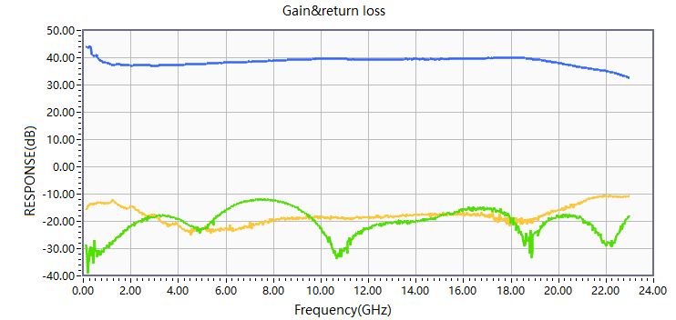
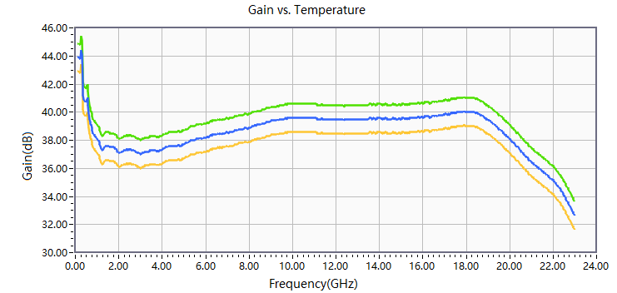


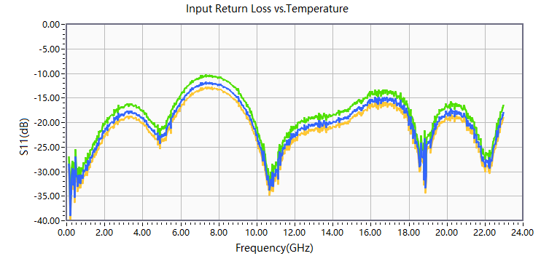
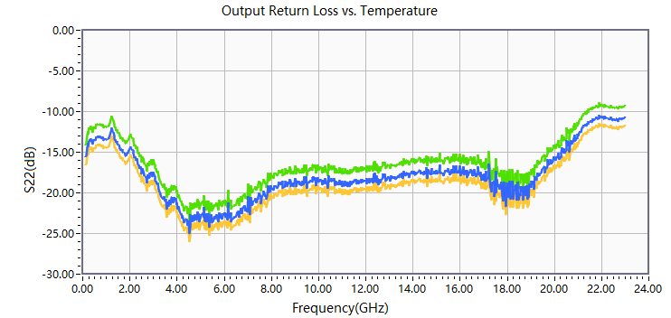
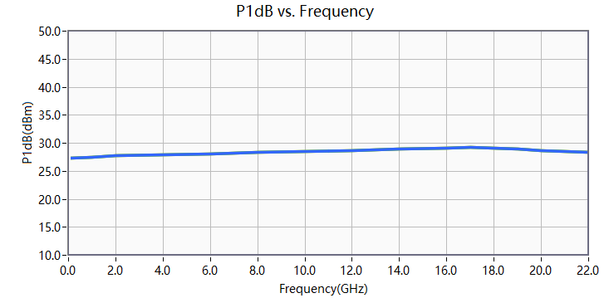
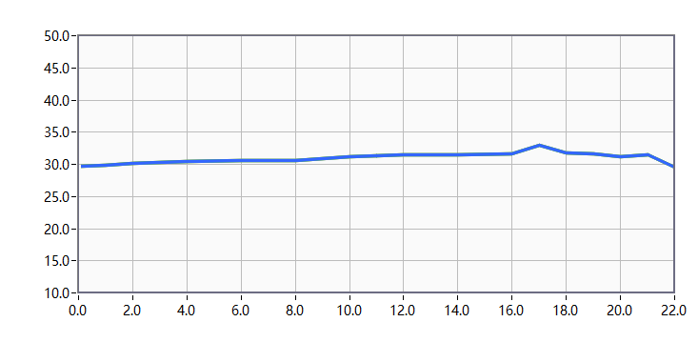
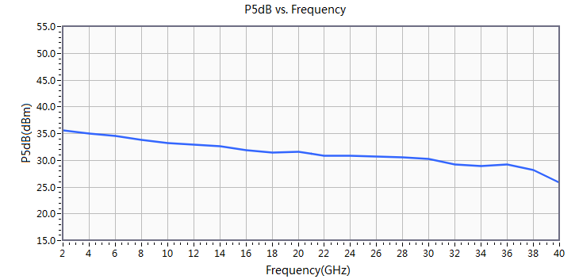
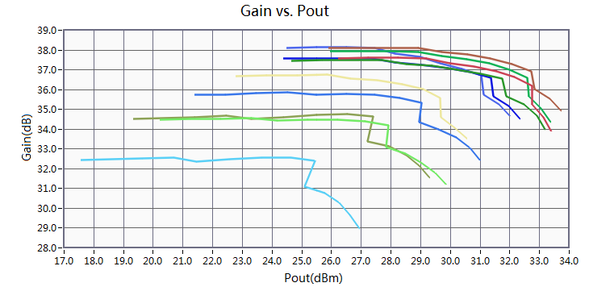
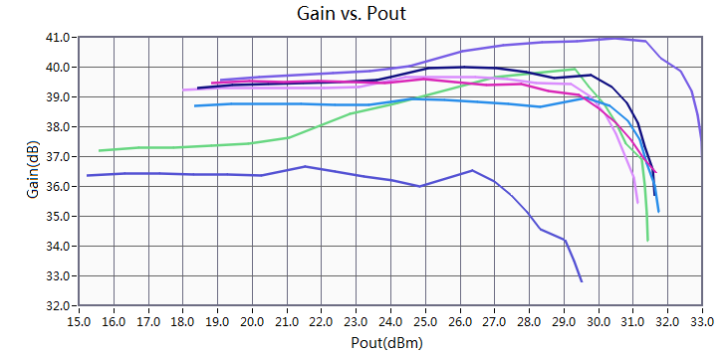

Performance Plot
2

