Slide 1
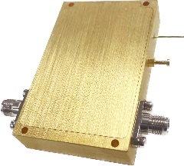


Description:
The power amplifier is a 1W power amplifier with a typical small signal gain of 33 dB across the frequency range of 0.1 to 22 GHz. The typical output power P-1 31dBm. The DC power requirement for the amplifier is +24 VDC/1.2 A. Accept customization according to different needs.
Radar Systems
Communication Systems
Receivers Systems
Electrical Specifications（+25℃）:
Parameter | Min. | Typ. | Max. | Units
Frequency Range | 0.1-22 |  |  | GHz
Gain | 30 | 33 |  | dB
Gain Flatness |  | ±2 |  | dB
Input VSWR |  | 1.6 | 2.0 | -
Output VSWR |  | 1.6 | 2.0 | -
Output Power for (P1dB) | 26 | 31 |  | dBm
Output Power Psat | 27 | 32 |  | dBm
OIP3 |  | 36 |  | dBm
Input Max Power(no damage) |  |  | 0 | dBm
DC Current (Vcc=+24V)(@Pout=1W) |  | 0.8 | 1.2 | A
Impedance | 50 |  |  | Ω
Input/Output Connector | SMA-Female
Material | Aluminium/Gold Painting
Weight | 60g
Package Sealing | General Sealing (Standard)
Environmental Specifications:
※ Operational Temperature | -25℃~+85℃
※ Storage Temperature | -55℃~+125℃
OBSERVE
PRECAUTIONS ELECTROSTATIC SENSITIVE DEVICES
1

Slide 2
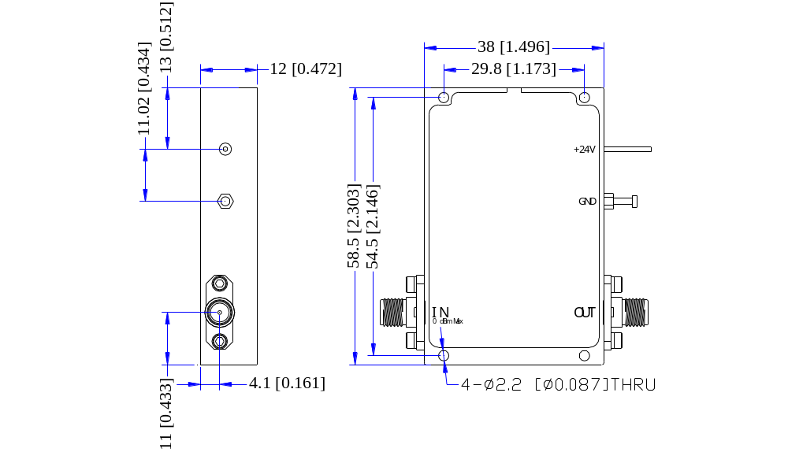
Outline Drawing
All Dimensions in mm（inches） Tolerance ±0.25（0.01）
***Heat Sink required during operation***
NOTE:
1. The product is designed to meet environmental ratings but not tested. If you need to test environmental condition, please contact our sales department.
2. Miczen technologies co., Ltd. reserves the right to change the above information without notice.
2

Slide 3
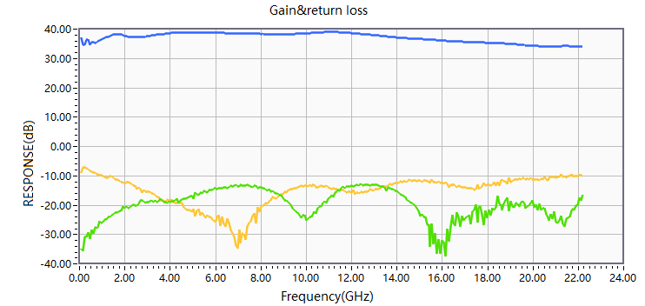
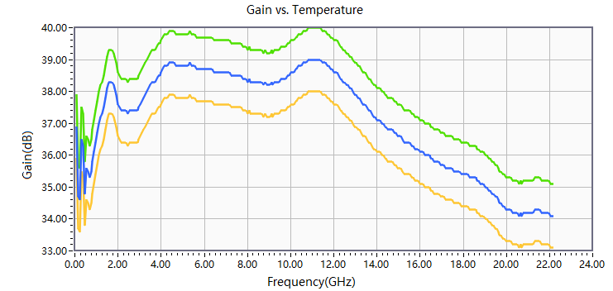


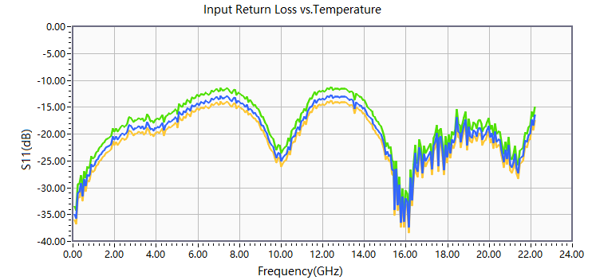
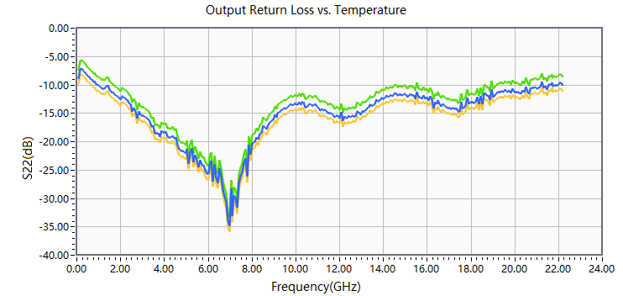
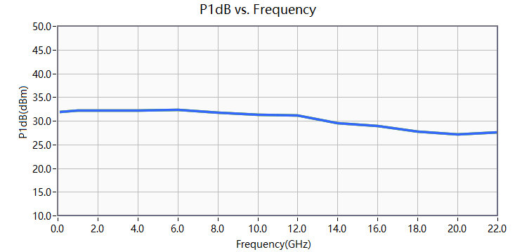
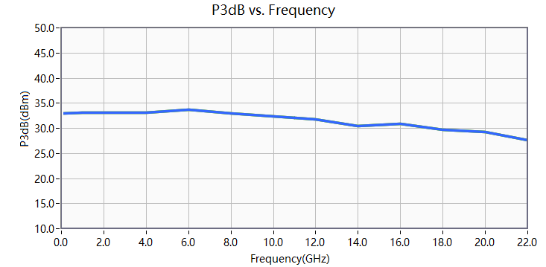
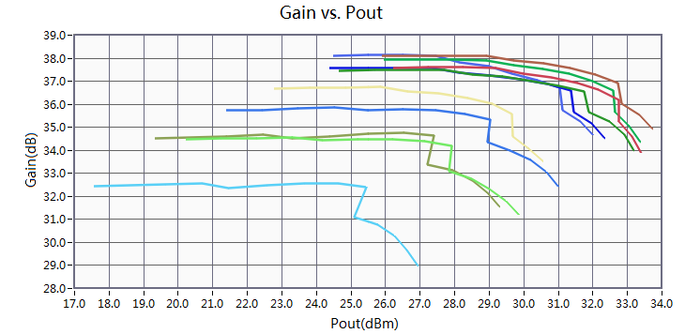
Performance Plot
2

