Slide 1
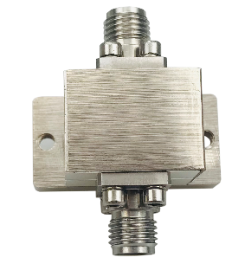


Description:
The Isolator is a coaxial isolator with a typical insertion loss of 1.5 dB and a typical isolation of 15dB across the frequency range of 18 to 26.5 GHz. The isolator can reach handling average power of -W. Accept customization according to different needs.
Radar Systems
Communication Systems
Receivers Systems
Electrical Specifications（+25℃）:
Parameter | Min. | Typ. | Max. | Units
Frequency Range | 22-33 |  |  | GHz
Insertion Loss |  | 1.6 | 1.7 | dB
Isolation | 13 | 15 |  | dB
VSWR |  | 1.6 | 1.8 | -
Forward Power (CW) |  |  | 10 | W
Reverse Power (CW) |  |  | 1 | W
Rotation | Clockwise (Standard) Counter Clockwise (upon request)
Impedance |  | 50 |  | Ω
Connector | 2.92-Female
Material | Copper
Weight | 30g
Package Sealing | Nickel Plated
Environmental Specifications:
※ Operational Temperature | -45℃~+85℃
※ Storage Temperature | -55℃~+105℃
OBSERVE
PRECAUTIONS ELECTROSTATIC SENSITIVE DEVICES
1

Slide 2
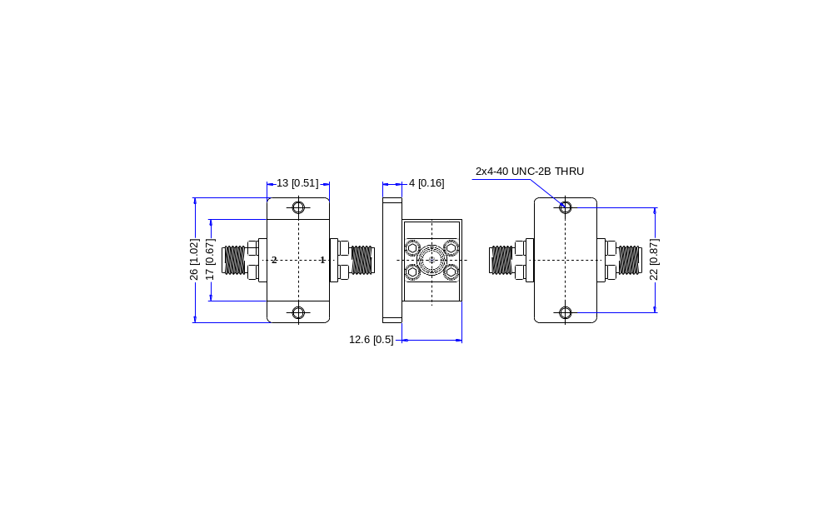
Outline Drawing
All Dimensions in mm（inches） Tolerance ±0.25（0.01）
NOTE:
1. The product is designed to meet environmental ratings but not tested. If you need to test environmental condition, please contact our sales department.
2. Miczen technologies co., Ltd. reserves the right to change the above information without notice.
2

Slide 3
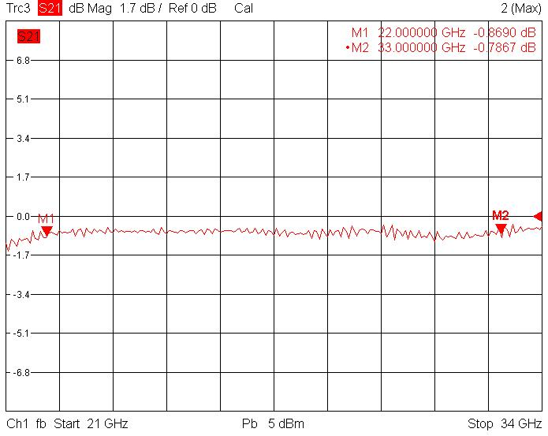
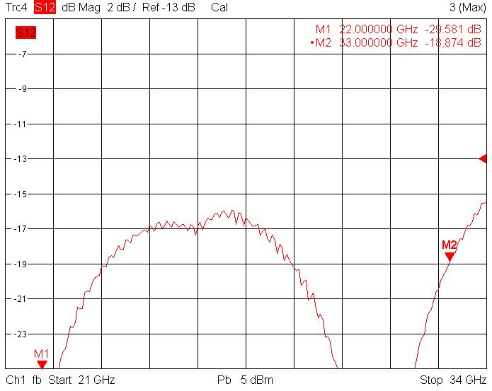
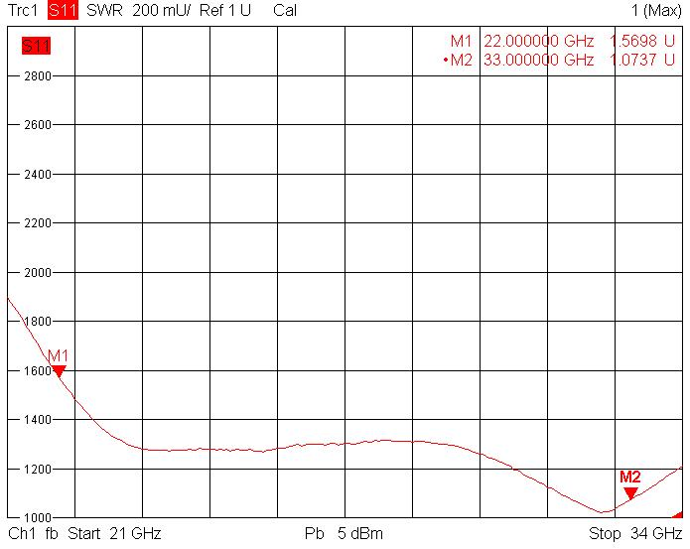
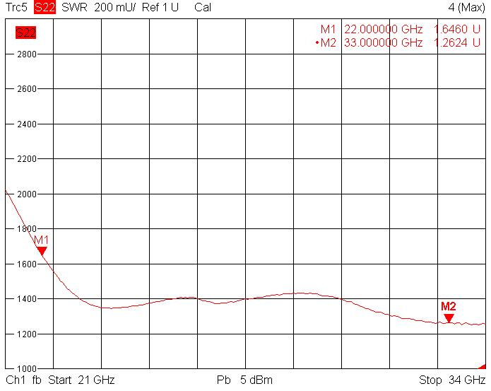
Performance Plot
Insertion Loss
Isolation
VSWR 1
VSWR 2
2

