Slide 1


Description:
The hybrid is a broadband 180° hybird with a typical insertion loss of 0.6 dB and a typical isolation of 22dB across the frequency range of 1 to 2 GHz. The directional coupler can reach handling power 50W. Accept customization according to different needs.
Radar Systems
Communication Systems
Receivers Systems
Electrical Specifications（+25℃）:
Parameter | Min. | Typ. | Max. | Units
Frequency Range | 1-2 |  |  | GHz
Insertion Loss |  |  | 0.6 | dB
Isolation | 22 |  |  | dB
VSWR |  |  | 1.4 | -
Amplitude Unbalance |  |  | ±0.5 | dB
Phase Unbalance |  |  | ±10 | °
Power Handling |  | 50 |  | W
Impedance |  | 50 |  | Ω
Connector | SMA-Female
Material | Aluminum
Weight | 160g
Package Sealing | Blue Color(Standard)
Environmental Specifications:
※ Operational Temperature | -45℃~+85℃
※ Storage Temperature | -55℃~+125℃
OBSERVE
PRECAUTIONS ELECTROSTATIC SENSITIVE DEVICES
1

Slide 2
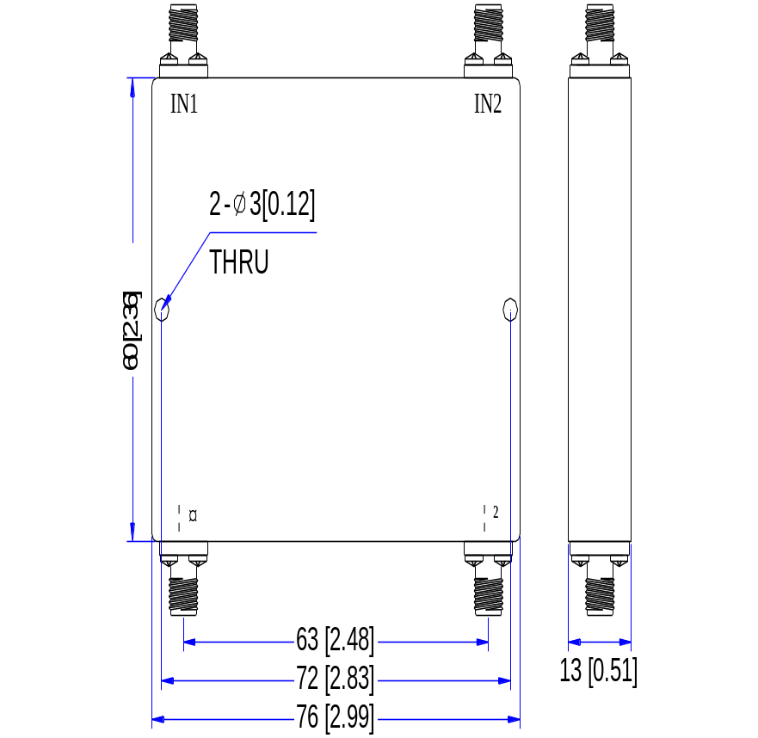
Outline Drawing
All Dimensions in mm（inches） Tolerance ±0.25（0.01）
NOTE:
1. The product is designed to meet environmental ratings but not tested. If you need to test environmental condition, please contact our sales department.
2. Miczen technologies co., Ltd. reserves the right to change the above information without notice.
2

Slide 3
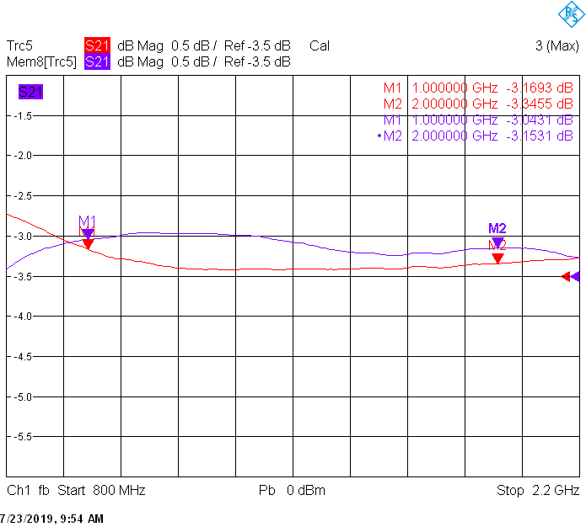
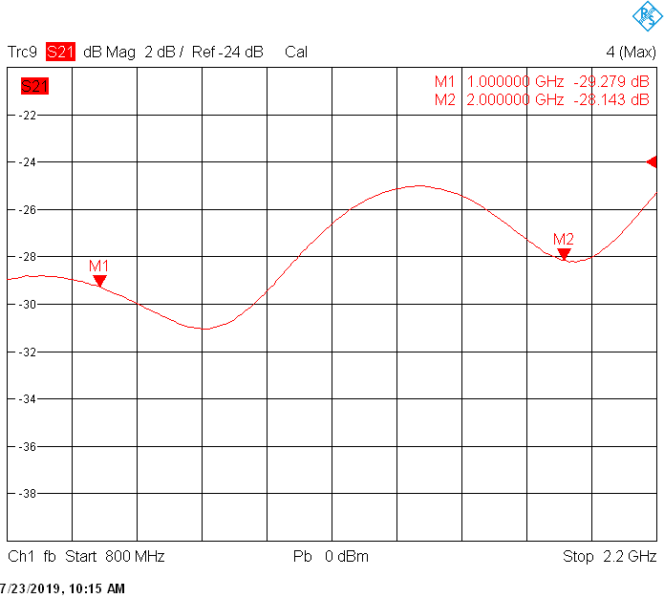
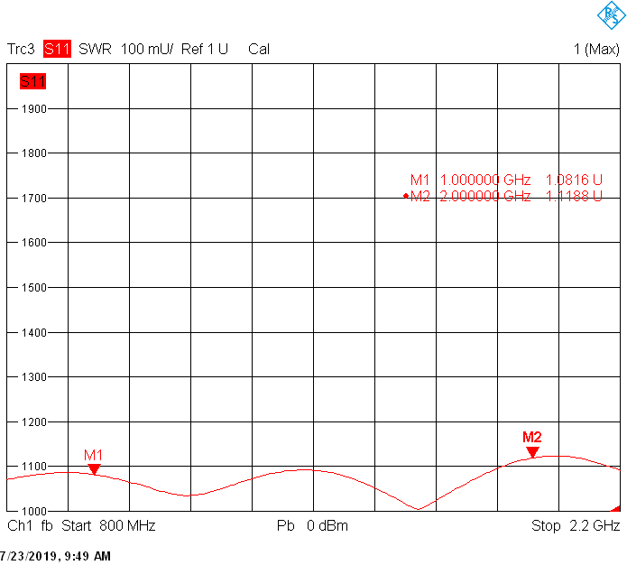
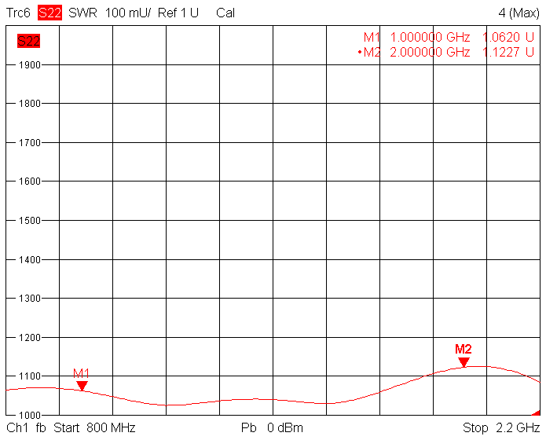
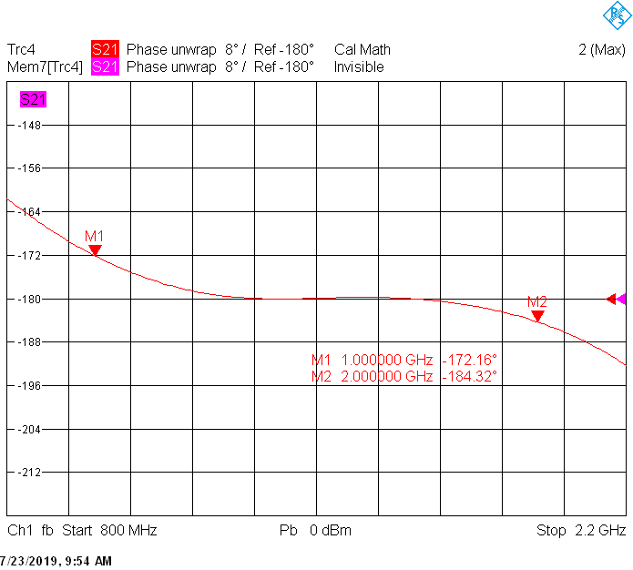
Performance Plot
Insertion loss & Amplitude Unbalance | Isolation
Input VSWR | Output VSWR
Phase Unbalance
2

