Slide 1
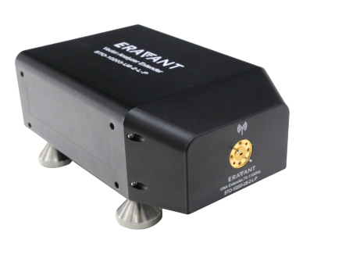


Description:
The extender moudle is a W band extender moudle with typical 5 dBm test port output Power. The output power regulation is -20
dB typ. The directivity for it is 35 dB typ. Accept customization according to different needs.
Radar Systems
Communication Systems
Receivers Systems
Electrical Specifications（+25℃）:
Parameter | Min. |  | Typ. | Max. | Units
Frequency Range | 60-90 |  |  |  | GHz
Test Port Output Power |  |  | +5 |  | dBm
Output Power regulation |  |  | -20 |  | dB
Dynamic Range @ 10 Hz Bandwidth | 100 |  | 110 |  | dB
Test Port Match |  |  | 30 |  | dB
Directivity |  |  | 35 |  | dB
RF Source Input Frequency | 10 |  |  | 15 | GHz
RF Source Input Power | 0 |  | +3 | +6 | dBm
LO Source Input Frequency(RF±IF) | 10 |  |  | 15 | GHz
LO Source Input Power | 0 |  | +3 | +6 | dBm
Input Maximum power |  |  |  | +10 | dBm
IF Frequency | 1Hz |  |  | 1000MHz
Magnitude Stability |  |  |  | 0.12 | dB
Phase Stability |  | 1.5 |  | 2 | °
Operating Temperature | +20 |  |  | +30 | ℃
RF Test Port | WR-12 Waveguide with UG387/U Anti-Cocking Flange
Output Connector | SMA-Female
AC Power Receptacle | FGG.0B.304.CLAD52Z
RF and LO Source Input Connector | SMA-Female/SMA-Female
Size | （122mmx61mmx182mm）
Environmental Specifications:
※ Operational Temperature | -25℃~+85℃
※ Storage Temperature | -55℃~+125℃
OBSERVE
PRECAUTIONS ELECTROSTATIC SENSITIVE DEVICES
1

Slide 2
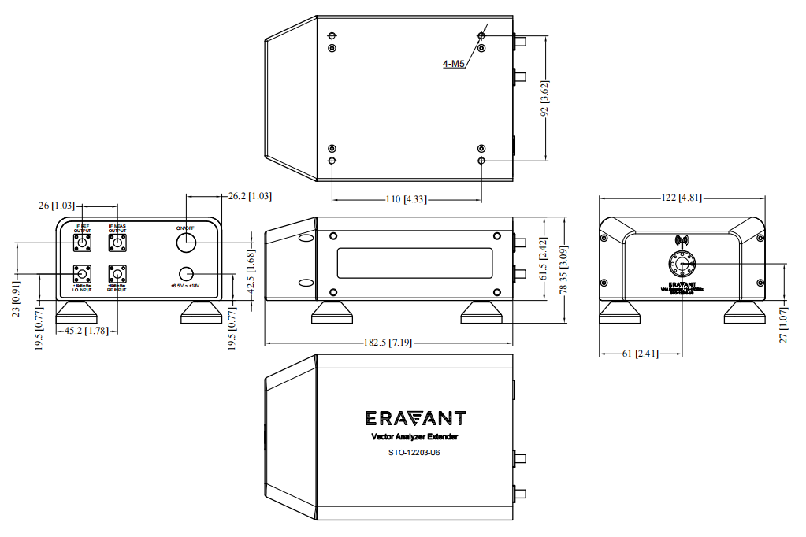
Outline Drawing
All Dimensions in mm（inches） Tolerance ±0.25（0.01）
***Heat Sink required during operation***
NOTE:
1. The product is designed to meet environmental ratings but not tested. If you need to test environmental condition, please contact our sales department.
2. Miczen technologies co., Ltd. reserves the right to change the above information without notice.
2

