Slide 1


Description:
The circulator is a coaxial circulator with a typical insertion loss of 1.0 dB and a typical isolation of 25dB across the frequency range of 33 to 40GHz. The circulator can reach handling average power of -W. Accept customization according to different needs.
Radar Systems
Communication Systems
Receivers Systems
Electrical Specifications（+25℃）:
Parameter | Min. | Typ. | Max. | Units
Frequency Range | 33-40 |  |  | GHz
Insertion Loss(Port 1 to Port 2 & Port 2 to Port 3) |  | 1.0 |  | dB
Isolation(Port 2 to Port 1 & Port 3 to Port 2) | 20 | 25 |  | dB
Insertion Loss(Port 3 to Port 1) |  | 30 |  | dB
Isolation(Port 1 to Port 3) | 16 | 18 |  | dB
Return Loss |  | 15 |  | dB
Forward Power (CW) |  | 10 |  | W
Reverse Power (CW) |  | 1 |  | W
Impedance |  | - |  | Ω
RF Input and Output | WR-22 Waveguide with UG-383/U Anti-Cocking Flange
Material | Aluminum
Weight | -g
Package Sealing | Gold Chem Film and Black Anodized
Environmental Specifications:
※ Operational Temperature | -45℃~+85℃
※ Storage Temperature | -55℃~+105℃
OBSERVE
PRECAUTIONS ELECTROSTATIC SENSITIVE DEVICES
1

Slide 2
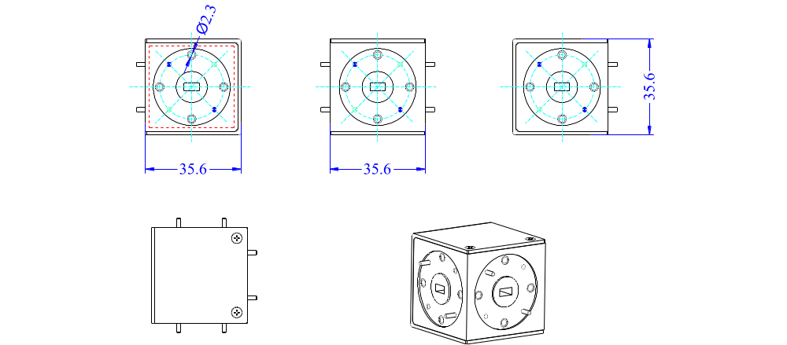
Outline Drawing
All Dimensions in mm（inches） Tolerance ±0.25（0.01）
NOTE:
1. The product is designed to meet environmental ratings but not tested. If you need to test environmental condition, please contact our sales department.
2. Miczen technologies co., Ltd. reserves the right to change the above information without notice.
2

