Slide 1
Features
Ultra Broadband
Low Insertion Loss
High Isolation
Rush Delivery
Fast Response
Customization Available Upon Request
Applications
Radar Systems
Communication Systems
Receiving Systems
Electrical Specifications
Parameter | Min | Typ | Max | Units
Frequency Range | 26.5-40 |  |  | GHz
Insertion Loss |  | 1.6 | 1.7 | dB
Isolation (Note 1) | 12 | 14 |  | dB
VSWR |  | 1.6 | 1.8 | -
Forward Power (CW) |  |  | 10 | W
Rotation | Clockwise (Standard) Counter Clockwise (upon request)
Input /Output Connector | 2.92-Female
Material | Copper
Finishing | Nickel Plated
Weight | - |  |  | g
Impedance | 50 |  |  | Ω
Note 1: Unit which has narrower frequency bandwidth can achieve higher isolation & low insertion loss Bandwidth (5 ~10) % x Center Frequency (Isolation >17dB) Bandwidth (20~30) % x Center Frequency (Isolation >16dB) Bandwidth (40~60) % x Center Frequency (Isolation >15dB)

Slide 2

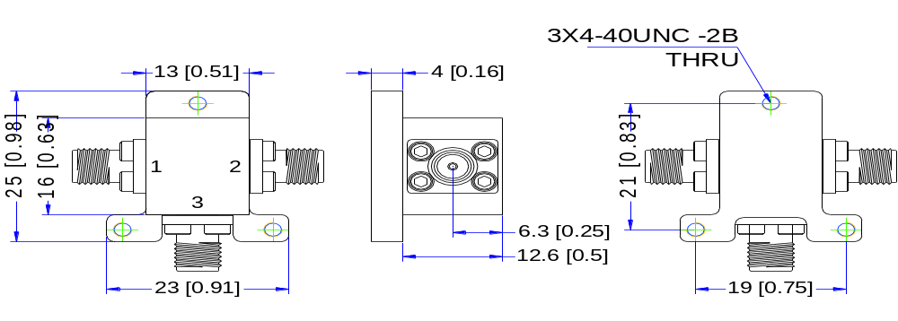
Environmental Conditions
Operational Temperature | -45℃~+85℃ | Vibration | 25g RMS (15 degrees 2KHz) endurance, 1 hour per axis
Storage Temperature | -55℃~+105℃ | Shock | 20G for 11msec half sine wave, 3 axis both directions
Executive Standard | MIL-STD-810G | Humidity | 100% RH at 35℃, 95%RH at 40℃
Outline Drawing
All Dimensions in mm（inches） Tolerance ±0.25（0.01）

Slide 3
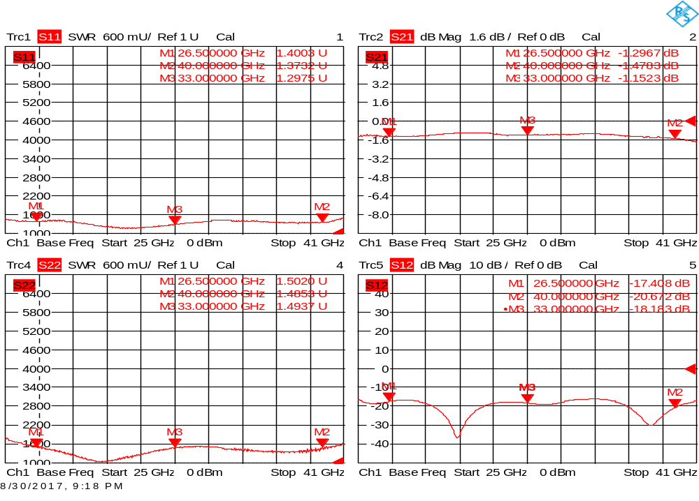
Performance Plot
Insertion Loss
Isolation
+
VSWR 1
VSWR 2

