Slide 1


Description:
The amplifier is a low noise amplifier with a typ small signal gain of 35 dB across the frequency range of 75 to 110 GHz. The typ output power P-1 -5 dBm. The DC power requirement for the amplifier is +8 VDC/0.1A. Accept customization according to different needs.
Radar Systems
Communication Systems
Receivers Systems
Electrical Specifications（+25℃）:
Parameter | Min. | Typ. | Max. | Units
Frequency Range | 75-110 |  |  | GHz
Gain |  | 35 |  | dB
Noise Figure |  | 5 |  | dB
Output Power for (P1dB) |  | -5 |  | dBm
Input Power |  |  | +5 | dBm
Input Return Loss |  | 6 |  | dB
Output Return Loss |  | 8 |  | dB
DC Voltage | 6 | 8 | 15 | VDC
DC Current (Vcc=+8V) |  | 0.1 |  | A
Input/Output Port | WR-10 Waveguide with UG-387/U Anticocking Flange
Material | Aluminium/3.Cover Material: Black Anodized Material: Aluminum/ Gold Plating
Weight | 1.6Oz
Package Sealing | General Sealing (Standard)
Environmental Specifications:
※ Operational Temperature | 0℃~+50℃
※ Storage Temperature | -25℃~+85℃
OBSERVE
PRECAUTIONS ELECTROSTATIC SENSITIVE DEVICES
1

Slide 2
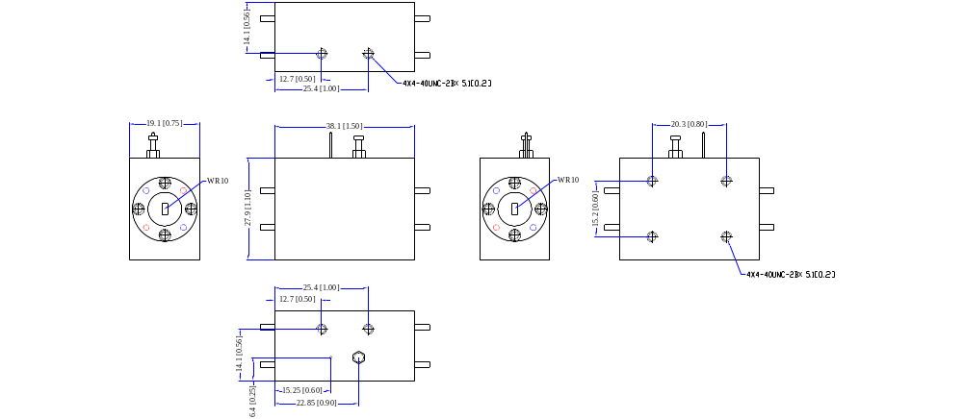
Outline Drawing
All Dimensions in mm（inches） Tolerance ±0.25（0.01）
***Heat Sink required during operation***
NOTE:
1. The product is designed to meet environmental ratings but not tested. If you need to test environmental condition, please contact our sales department.
2. Miczen technologies co., Ltd. reserves the right to change the above information without notice.
2

