Slide 1
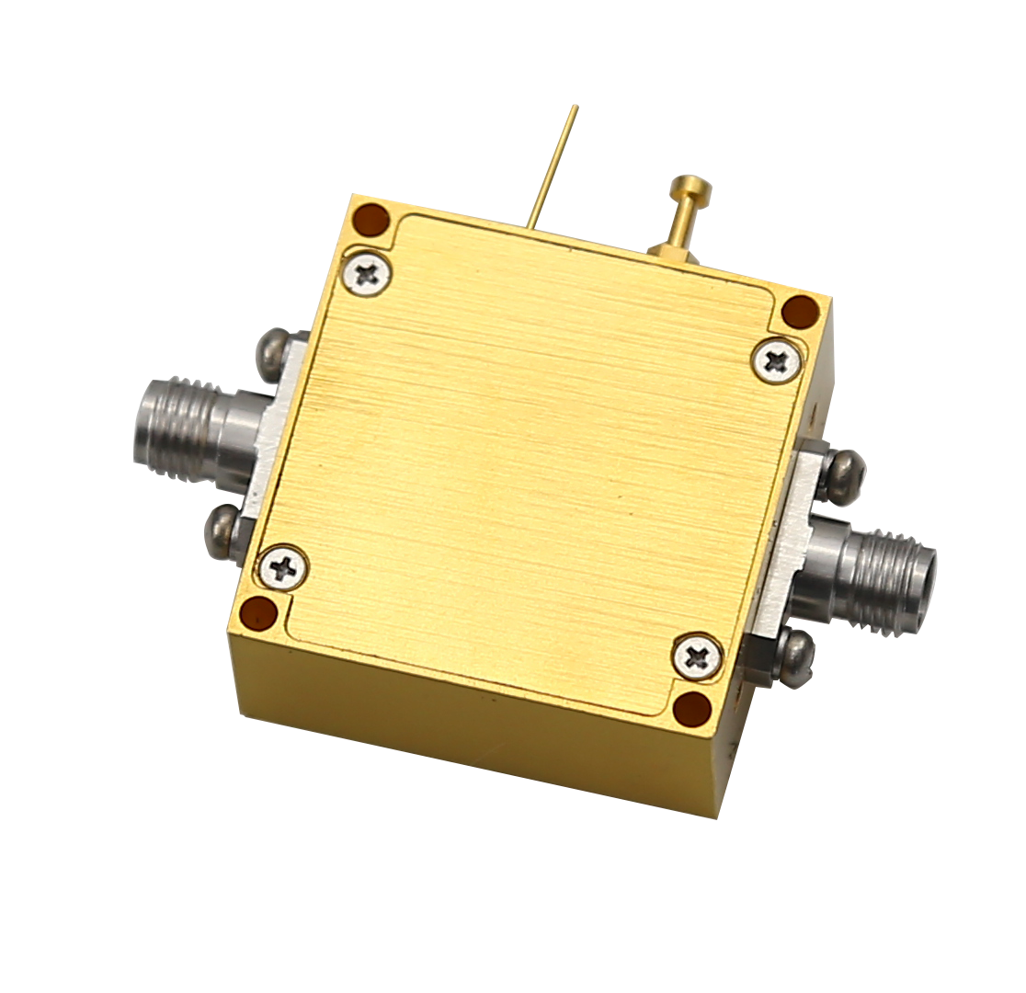


Description:
The amplifier is a low noise amplifier with a typical small signal gain of 25 dB and a typical noise figure of 5 dB across the frequency range of 40 to 60 GHz. The typical output power P-1 15dBm. The DC power requirement for the amplifier is +8 VDC/250 mA. Accept customization according to different needs.
Radar Systems
Communication Systems
Receivers Systems
Electrical Specifications（+25℃）:
Parameter | Min. | Typ. | Max. | Units
Frequency Range | 40-60 |  |  | GHz
Gain | 20 |  | 30 | dB
Gain Flatness |  | ±3 |  | dB
Input VSWR |  | 2.0 |  | -
Output VSWR |  | 2.0 |  | -
Output Power for (P1dB) |  | 15 |  | dBm
Output Power Psat |  | 17 |  | dBm
Spurious |  | -60 |  | dBc
Noise Figure |  | 5.0 |  | dB
Output IP3 |  | 25 |  | dBm
Input Max Power(no damage) |  |  | -10 | dBm
DC Current (Vcc=+8V) |  | 250 |  | mA
Impedance | / |  |  | Ω
Input/Output Connector | WR19 UG-383/U
Material | Aluminium\Gold Painting
Weight | 100g
Package Sealing | General Sealing (Standard)
Environmental Specifications:
※ Operational Temperature | -25℃~+85℃
※ Storage Temperature | -55℃~+125℃
OBSERVE
PRECAUTIONS ELECTROSTATIC SENSITIVE DEVICES
1

Slide 2
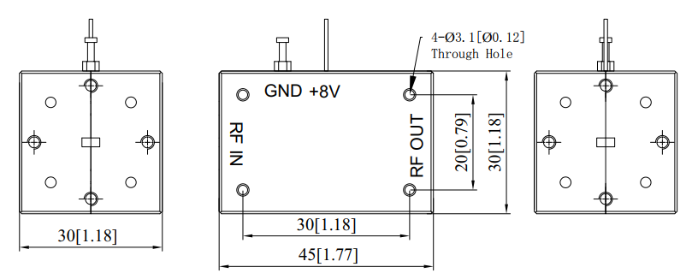
Outline Drawing
All Dimensions in mm（inches） Tolerance ±0.25（0.01）
***Heat Sink required during operation***
NOTE:
1. The product is designed to meet environmental ratings but not tested. If you need to test environmental condition, please contact our sales department.
2. Miczen technologies co., Ltd. reserves the right to change the above information without notice.
2

