Slide 1


Description:
The Isolator is a coaxial isolator with a typical Loss insertion of 0.3 dB and a typical isolation of 20dB across the frequency range of 2.57 to 2.62 GHz. The isolator can handing average power of 20W. Accept customization according to different needs.
Radar Systems
Communication Systems
Receivers Systems
Electrical Specifications（+25℃）:
Parameter | Min. | Typ. | Max. | Units
Frequency Range | 2.57-2.62 |  |  | GHz
Insertion Loss |  |  | 0.3 | dB
Isolation | 18 |  |  | dB
Return Loss | 18 |  |  | dB
Average Power (CW) |  | 20 |  | W
PIMD 3rd |  | -65 |  | dBc
Impedance |  | 50 |  | Ω
Connector | SMA-male/SMA-Female
Material | BODY: Steel/TAB: BeCu
Direction | CCW
Weight | -
Package Sealing | BODY: Nickel plate/TAB: Silver Plated
Environmental Specifications:
※ Operational Temperature | -45℃~+85℃
※ Storage Temperature | -55℃~+105℃
OBSERVE
PRECAUTIONS ELECTROSTATIC SENSITIVE DEVICES
1

Slide 2
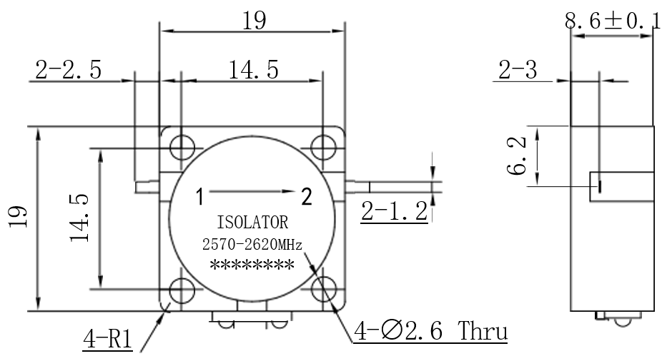
Outline Drawing
All Dimensions in mm（inches） Tolerance ±0.25（0.01）
NOTE:
1. The product is designed to meet environmental ratings but not tested. If you need to test environmental condition, please contact our sales department.
2. Miczen technologies co., Ltd. reserves the right to change the above information without notice.
2

