Slide 1


Description:
The circulator is a coaxial circulator with a typical Loss insertion of 0.35 dB and a typical isolation of 18dB across the frequency range of 10 to 12.4 GHz. The circulator can reach handling average power of 50W. Accept customization according to different needs.
Radar Systems
Communication Systems
Receivers Systems
Electrical Specifications（+25℃）:
Parameter | Normal temperature characteristic |  |  |  | Full temperature characteristic |  |  |  | Units
 | Min. | Typ. |  | Max. | Min. | Typ. |  | Max.
Frequency Range | 10-12.4 |  |  |  |  |  |  |  | GHz
Insertion Loss |  |  |  | 0.3 |  |  |  | 0.35 | dB
Isolation | 20 |  |  |  | 18 |  |  |  | dB
VSWR |  |  |  | 1.25 |  |  |  | 1.3 | -
Forward Power (CW) |  |  |  |  |  | 50 |  |  | W
Reverse Power (CW) | Clockwise (Standard) Counter Clockwise (upon request)
Impedance |  |  | 50 |  |  |  |  |  | Ω
Connector | SMA-Female
Material | Aluminum
Weight | -g
Environmental Specifications:
※ Operational Temperature | -40℃~+70℃
※ Storage Temperature | -45℃~+75℃
OBSERVE
PRECAUTIONS ELECTROSTATIC SENSITIVE DEVICES
1

Slide 2
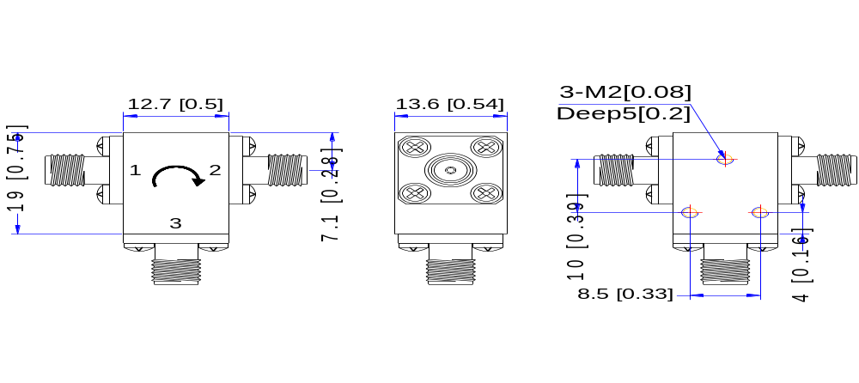
Outline Drawing
All Dimensions in mm（inches） Tolerance ±0.25（0.01）
NOTE:
1. The product is designed to meet environmental ratings but not tested. If you need to test environmental condition, please contact our sales department.
2. Miczen technologies co., Ltd. reserves the right to change the above information without notice.
2

